Slide 1
Food Sector Network Meeting
February 2022

Slide 2
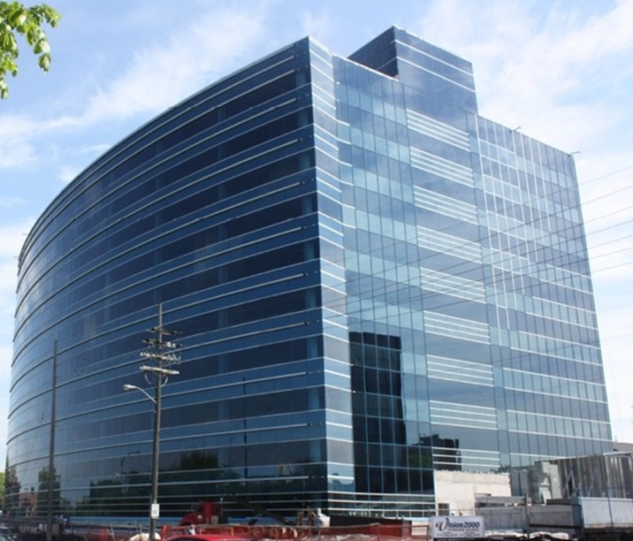
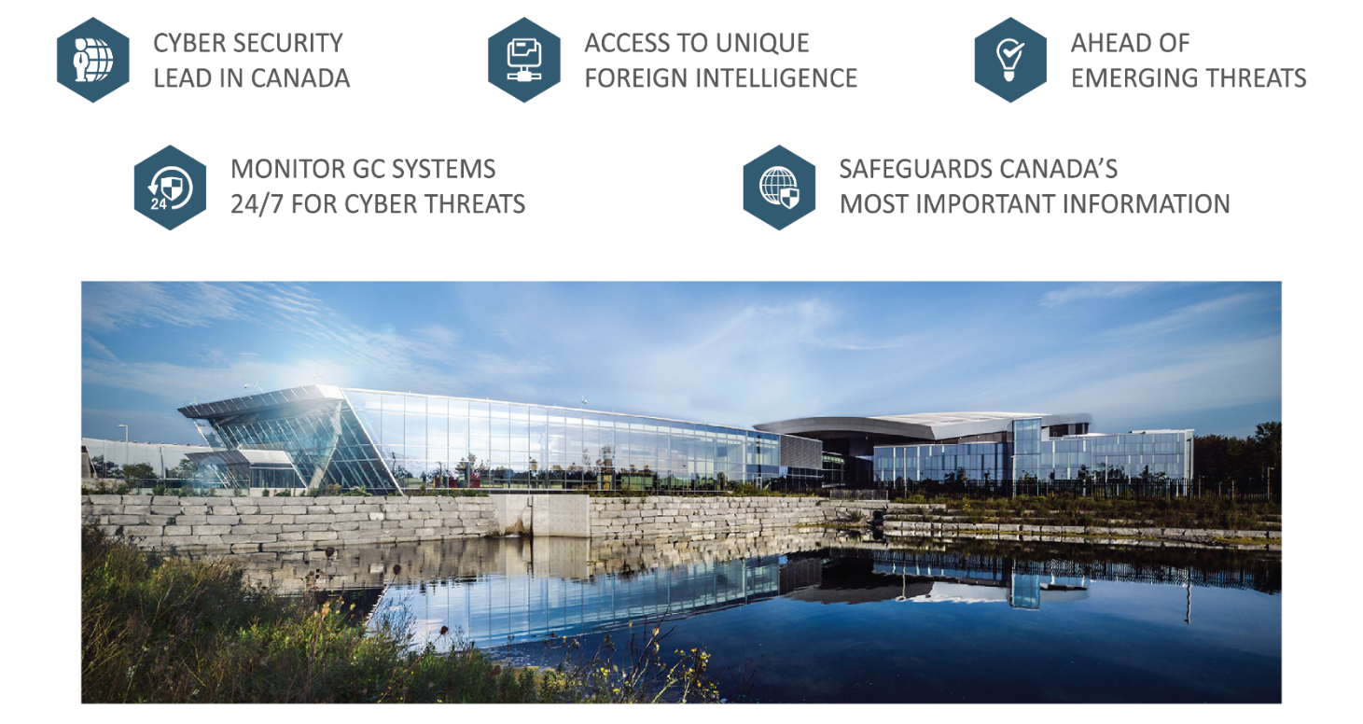

CommunicaTION Security Establishment’Sn (CSE)
Role in Cyber Security

Slide 3

THE THREAT LANDSCAPE
National Cyber Threat Assessment – 2020
Cybercriminals represent the most pervasive cyber threat to Canadians
  Ransomware and Phishing attacks
State sponsored cyber threat actors have most sophisticated capabilities
  Cyber espionage, IP theft, online influence campaigns, disruptive cyber attacks
  National Cyber Threat Assessment 2020

Slide 4
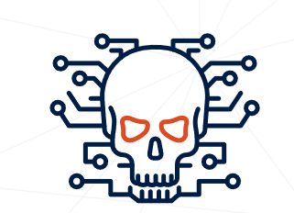

THE THREAT LANDSCAPE
IMPACT OF COVID-19 ON CYBER THREAT
Cyber Threat Bulletin: Impact of COVID-19 on Cyber Threats
  Cyber espionage directed at Canada will continue to attempt to steal Canadian intellectual property relating to COVID-19 vaccine and treatment research
  Cyber threat actors are identifying individuals working at home and exploiting technologies deployed in support of a remote workforce, such as VPNs
  Cyber threat actors will leverage COVID-19 as a thematic lure for their malicious activities

Slide 5
THE THREAT LANDSCAPE
THE RANSOMWARE THREAT IN 2021
First half of 2021, global ransomware attacks increased by 151% when compared of the first half of 2020 (fueled by Ransomware-as-a-service)
2021 was marked by the highest ransoms and the highest payouts
  In Canada, average cost of a data breach (includes ransomware) was $6.35M CAD
  Global average cost of recovery from ransomware incident (paying ransom / remediating compromised network) increased from $970 000 CAD in 2020 to $2.3M CAD in 2021
Cyber Center is aware of 235 ransomware incidents against Canadian victims from Jan 1 to Nov 16 2021
Once targeted, ransomware victims are often attacked multiple times

Slide 6
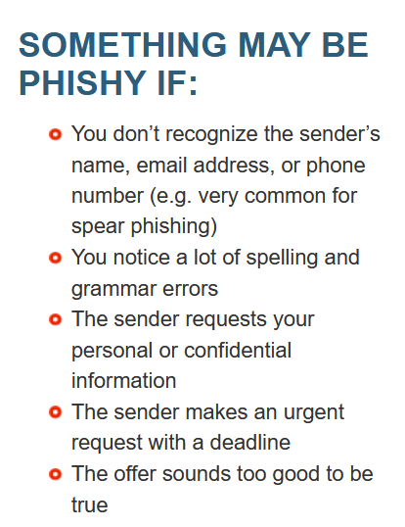
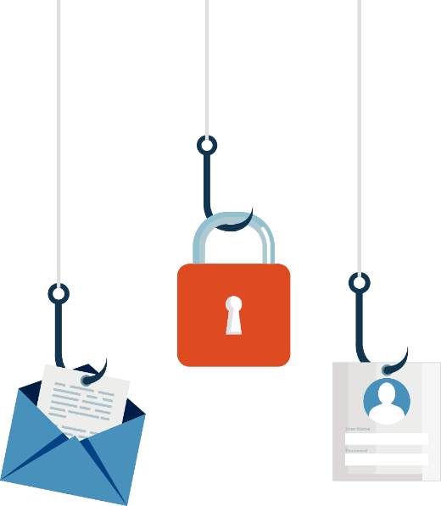
PHISHING
Phishing is the number one delivery vehicle for ransomware.
  Phishing, SMiSing, Vishing, Quishing
  Don’t Take the Bait: Recognize and Avoid Phishing Attacks
  The 7 red flags of Phishing

Slide 7
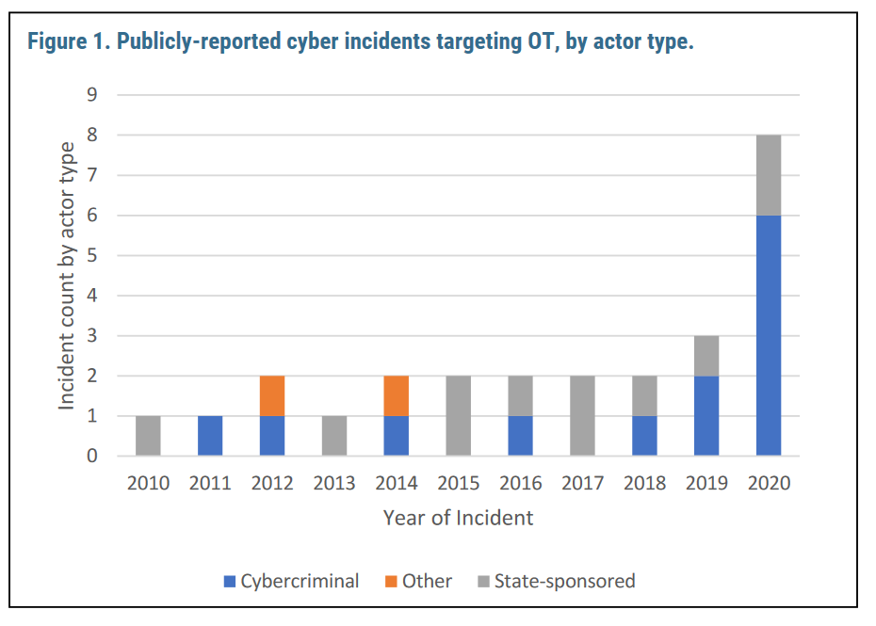
THE THREAT LANDSCAPE
CYBER THREAT TO OPERATIONAL TECHNOLOGY
Operational Technology (OT) plays an essential role in the management of Canada’s CI
Digital transformation of OT is providing cyber threat actors new opportunities to access and disrupt OT systems
2020 saw a spike in cyber threat activity against OT systems around the world

Slide 8
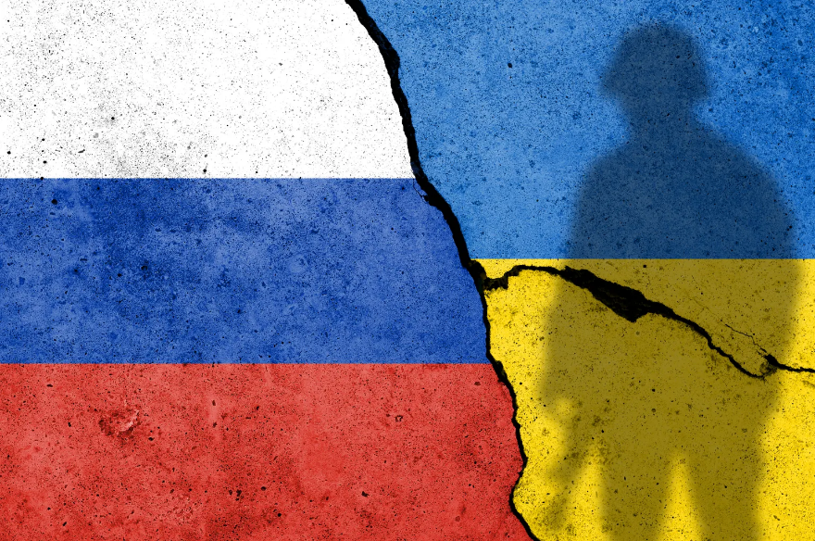
THE THREAT LANDSCAPE
RUSSIAN-BACKED CYBER THREAT ACTIVITY
Should the current Ukraine crisis escalate, Russia will very likely attack the CI of perceived adversaries
Be prepared to isolate CI components and services from the Internet
Increase monitoring of your networks
Enhance security posture (patch systems, enable logging, etc.)

Slide 9
HOW CAN I PROTECT MY ORGANIZATION?
Regularly back up your data and store off-line. LINK
Use strong and unique passwords, implement MFA. LINK
Update and patch systems. LINK
Have an Incident Response Plan (and test it!) LINK
Use security tools. LINK
Cyber Center’s Baseline Cyber Security Controls for SMO
ISED’s CyberSecure Canada eLearning

Slide 10
CCCS Ransomware Publications
Ransomware Playbook
  Top Measures to Enhance CyberSecurity for SMO
    Links from previous slide come from this Publication
  Spotting Malicious Email Messages
  Ransomware: How to prevent and recover
  Ransomware: How to recover and get back on track
  Have You Been A Victim of Cyber Crime?

Slide 11







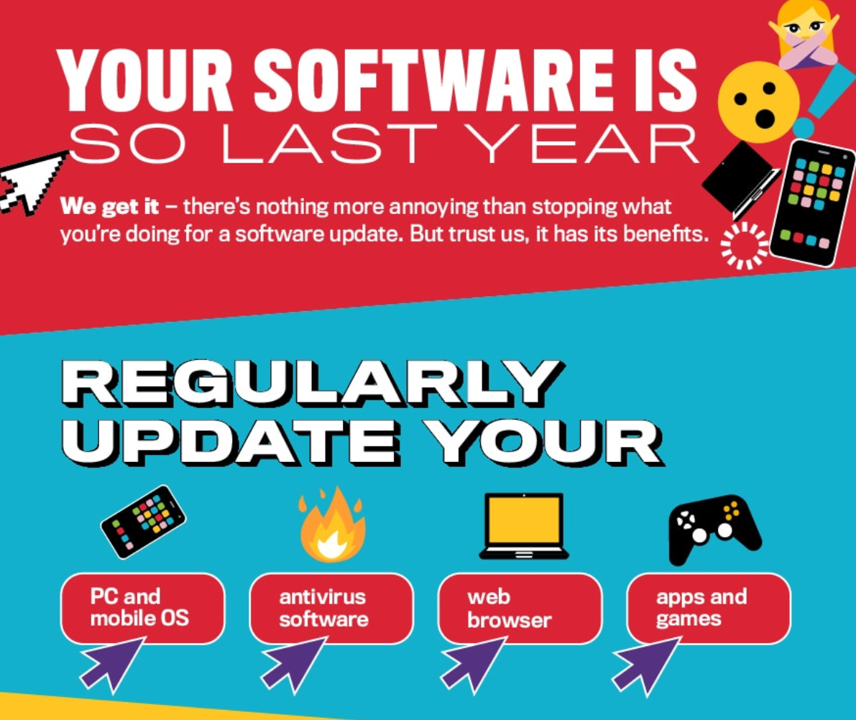
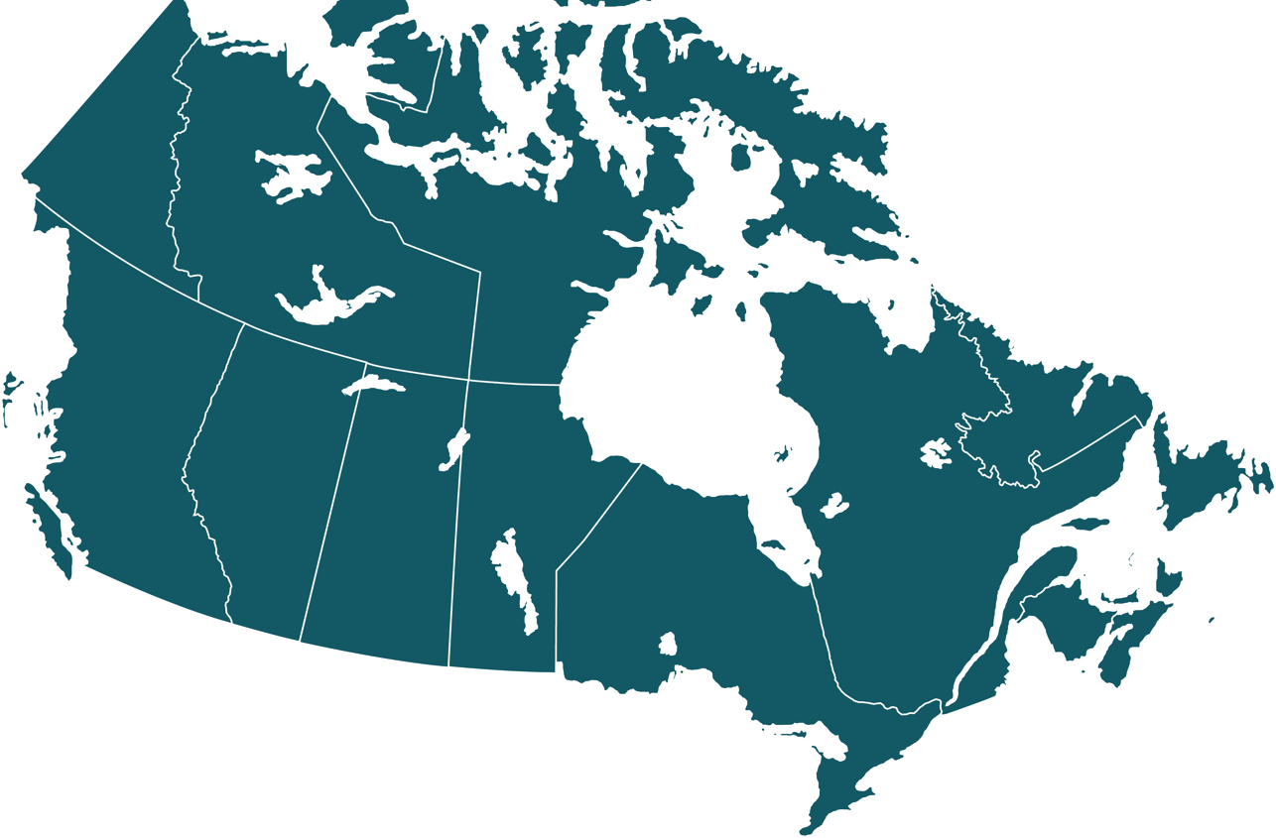
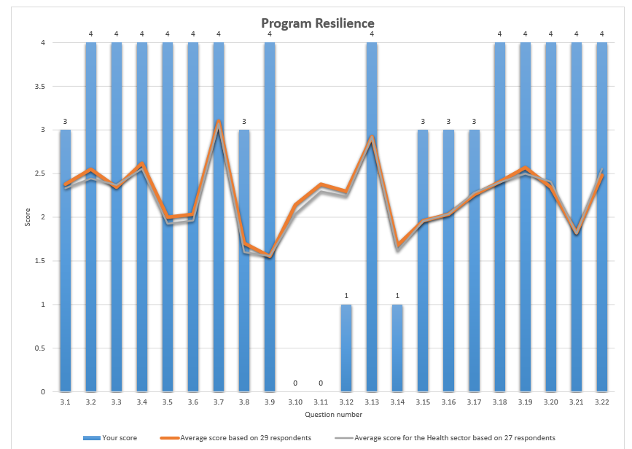
THE ROLE OF THE CYBER CENTRE
For Free Cyber Center Services: contact@cyber.gc.ca
INCIDENT HANDLING SUPPORT
THREAT INTELLIGENCE
COMMUNITY
BUILDING
ADVICE & GUIDANCE
CYBER DEFENCE SERVICES
24/7 SUPPORT
contact@cyber.gc.ca
ACCESS TO ACTIONABLE CYBER THREAT INTELLIGENCE
Alerts, Advisories
FURTHER CYBER SECURITY TOGETHER
LEVERAGE THE CYBER CENTRE’S EXPERTISE Publications
STRENGTHEN YOUR DEFENCE CAPABILITIES
Assessments, Vulnerability Notifications, Sharing IoCs, etc.

Slide 12
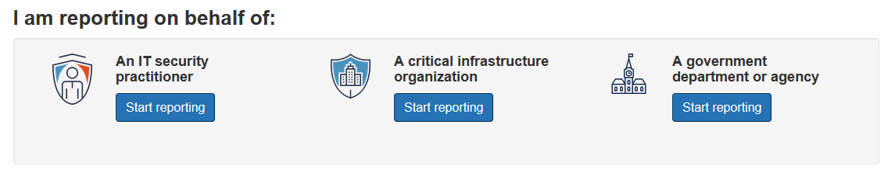

PLEASE REPORT A CYBER INCIDENT
Incident Reporting Portal:
https://cyber.gc.ca/en/incident-management
cyberincident@cyber.gc.ca
contact@cyber.gc.ca

